Slide 1
2020 IED TEAM PROJECT
NPU for Patient With Mental Illness
Group 1
21700045 권동성
21700302 박준석
21900055 금아현
21900740 최동희

Slide 2
CONTENTS
Introduction
- NPU for mental patients
Research
- Interview
- Articles
Problems
Conclusion
- Prioritizing
- Questions

Slide 3
Introduction
What is NPU?
NPU
Negative Pressure Unit
: an isolated room that prevents cross-contamination from room to room

Slide 4
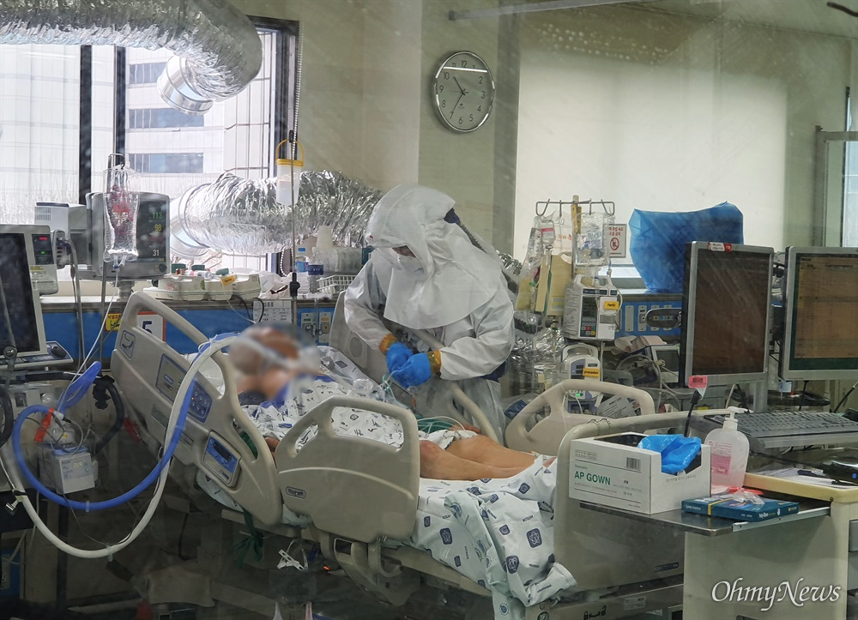

Slide 5
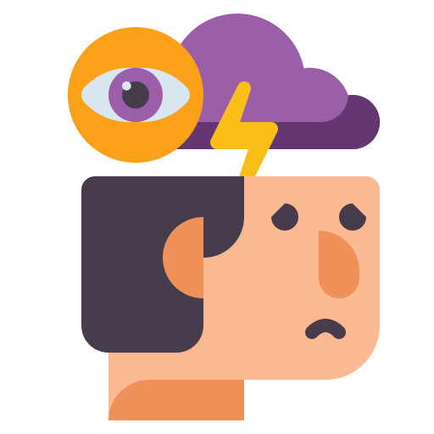

Slide 6
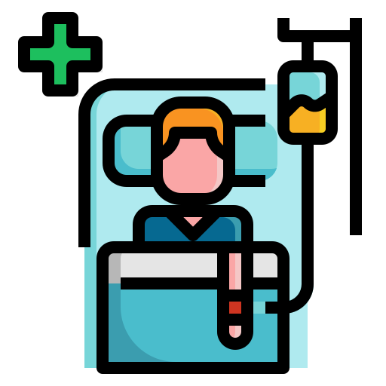

Introduction
Specify Users

Slide 7

Research
Articles
- Cost
- How they communicate

Slide 8


Research
Interview with a potential user
They are emotionally unstable.
Emotional support is therefore essential.

Slide 9

Problems
Cost
Installation cost
Maintenance cost

Slide 10

Problems
Cost
Anxiety
Installation cost
Maintenance cost
Environmental changes

Slide 11

Problems
Cost
Anxiety
Communication
Installation cost
Maintenance cost
Absence of mental support
Lack of direct communication
Environmental changes

Slide 12
Conclusion
Prioritization
Goals | Cost | Communication | Anxiety | Sum/Win
Cost | ···· | 1+1+1+1 | 1+1+1+1 | 8
Communication | 0+0+0+0 | ···· | 0+0+0+0 | 0
Anxiety | 0+0+0+0 | 1+1+1+1 | ···· | 4
Sum/Lose | 0 | 8 | 4 | ····

Slide 13
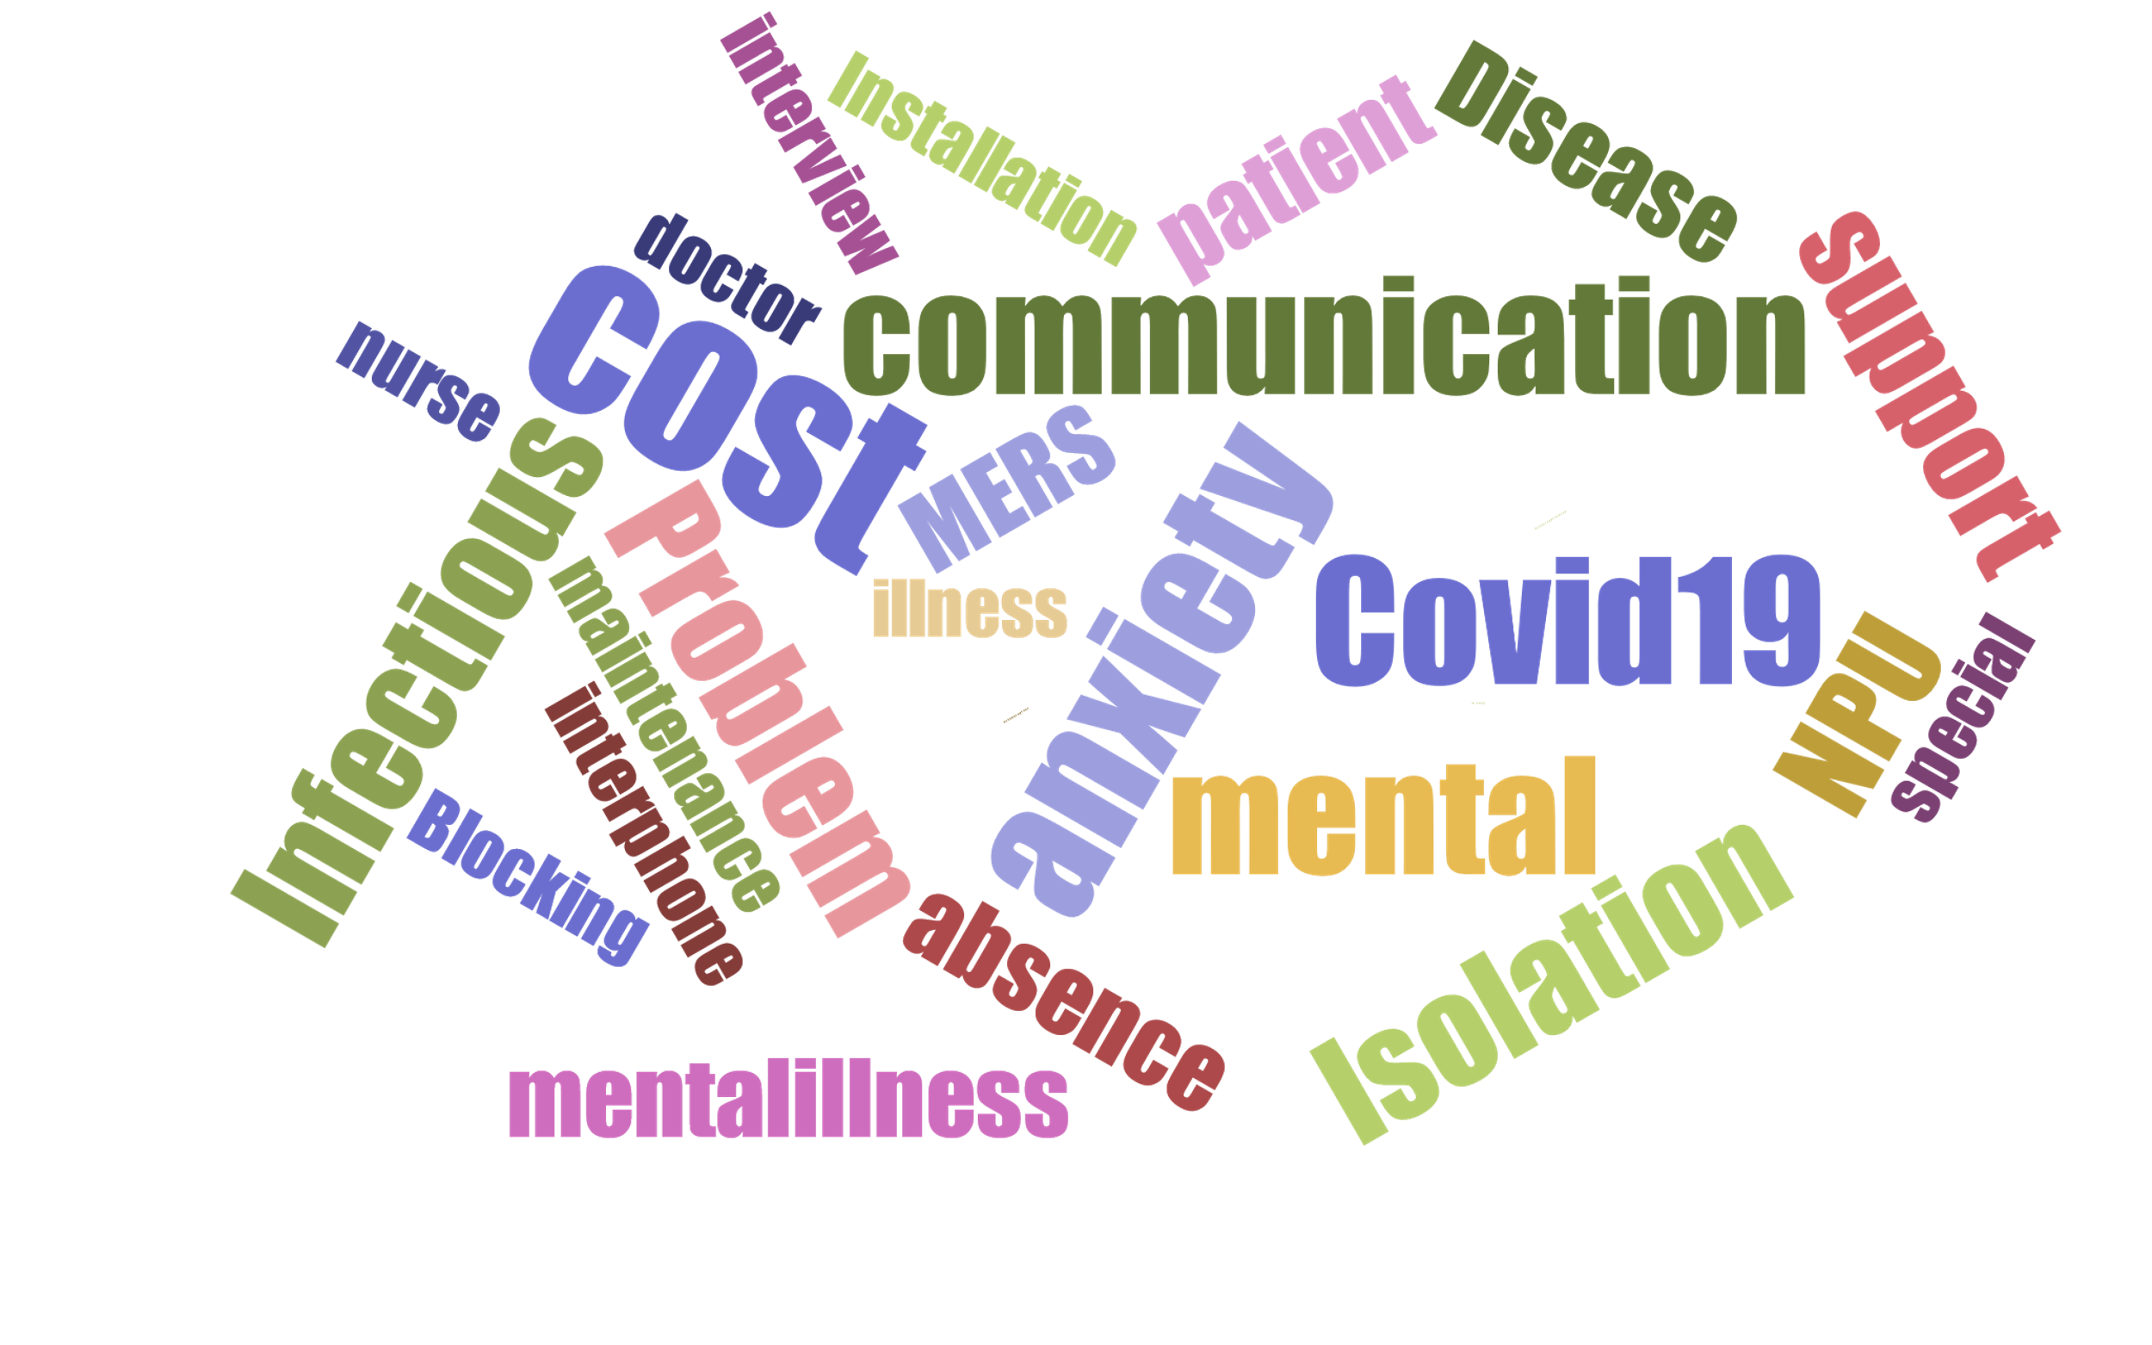
Conclusion

Slide 14
Conclusion
Question
Would there be any method to figure out the amount of pain if patients with mental illness cannot express it themselves?

Slide 15
Source
https://www.flaticon.com/
http://ojsfile.ohmynews.com/PHT_IMG_FILE/2020/0310/IE002614208_PHT.jpg
https://www.kha.or.kr/main
https://www.pharmnews.com/news/articleView.html?idxno=100043

Slide 16
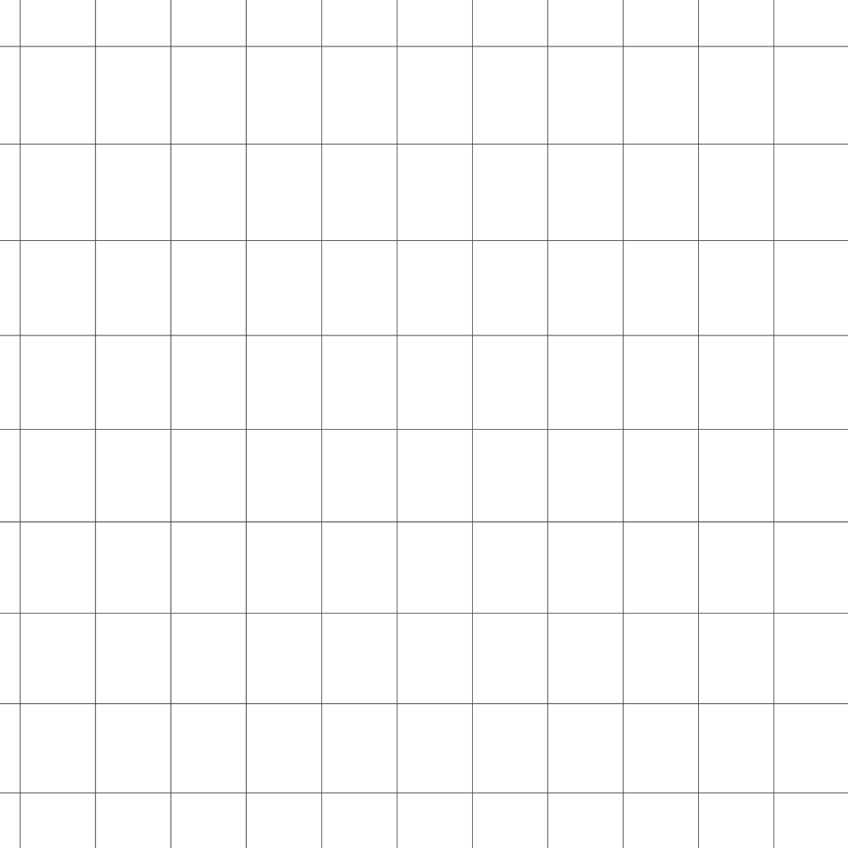
Thank You!

